Slide 1

Building Azure Search Apps
Notes:
Joe Zack, dev, podcaster, pokefan
Building applications Azure Search
Overview of search engines
Add a search engine to an existing site
Whirlwind tour of advanced features in Azure Search
Ready and able to go build some apps, and drop links in the comments below
https://www.kisspng.com/png-squirtle-pikachu-pokmon-blastoise-charmander-squ-4321888/

Slide 2
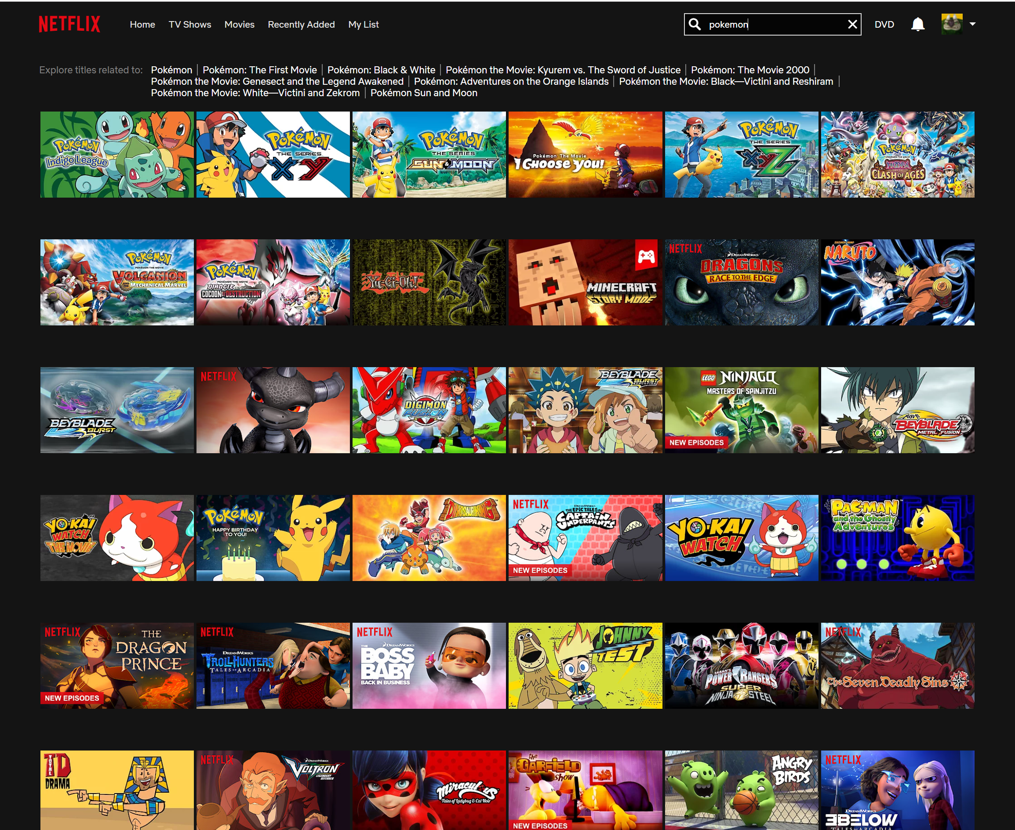
Notes:
Search is a core tenet of the modern usability
It’s a huge part of how we interact with data and really, a huge part of how we interact with the world
Watching tv, coding is difficult, phone without going through with sort of search interface
But…I’m not very good at it
I typo, I don’t know what I’m looking for until I see it – or until google suggests it to me
--
How are these interactions are built
https://ardorseo.com/blog/how-many-google-searches-per-day-2018/
https://www.scrapehero.com/many-products-amazon-sell-january-2018/
https://stackexchange.com/performance

Slide 3
https://www.eetimes.com/author.asp?section_id=36&doc_id=1330462
Notes:
To make matters worse, every year there is more data in existence
and every year my customers are expecting more out of my software – because they are getting used to the rich experiences they have with Google and Amazon, and Netflix
But I’m okay with that, because my software development tools are also getting better and better every year

Slide 4
Why not RDBMS?
ACID Compliant
Reliable
Common
Notes:
As a developer, I write a lot of software that let humans interact with data and search is a really big part of that – so I need to make sure that I understand my options.
Ultimately the app I’m going to demo today can be built in other ways – including traditional relational databases,
but YOU, the dev, are going to be doing a lot of extra work to deliver the kinds of search experience that people are used to.
Any time you spend coding features like synonyms, stemming, fuzzy search, bucketing, or auto-suggest that come out of the box with modern search engines
is less time spent on the parts of your app that are unique to your problem domain.

Slide 5
Is it worth it?
Notes:
That said, there are reasons to stick with what you’ve got.
* You already know how to use your current tools and you’ve got inertia with them
If you work on a team, then you don’t need to convince anybody else
Search engine needs to be maintained, so they need to bring a LOT of value to the table in order for you to even consider
Adding it to your toolchain
Let’ work through a sample application, so we can get a glimpse of those benefits.

Slide 6
Azure Search
Stop Words
Stemming
Synonyms
Fuzzy Searching
Auto Suggest
Auto-Bucketing
Location searches
Relevance tuning
Advanced Query DSL
Easy import
Notes:
Quick shot of the features that demo got out of Azure Search.
These are the types of things that users expect out of search, and are hard to implement well on your ow

Slide 7
Features we didn’t see
Highlighting
Geo Fencing
Cognitive search
Monitoring and Reporting
Managed Infrastructure
Field boosting
Notes:
Quick shot of the features that demo got out of Azure Search.
These are the types of things that users expect out of search, and are hard to implement well on your ow

Slide 8
Azure vs…
Solution | Min | Environment
Azure Search | Free | SAAS
Algolia | Free | SAAS
AWS CloudSearch | $43 | SAAS
SOLR | Free | Any
Elasticsearch | Free | Any
Notes:
It’s tough to compare apples to apples, but
Best offering: Elasticsearch (REST API, Ecosystem) but you are going to pay
Azure Search – lucene based, highly compatible with other search engines, low barrier to entry

Slide 9
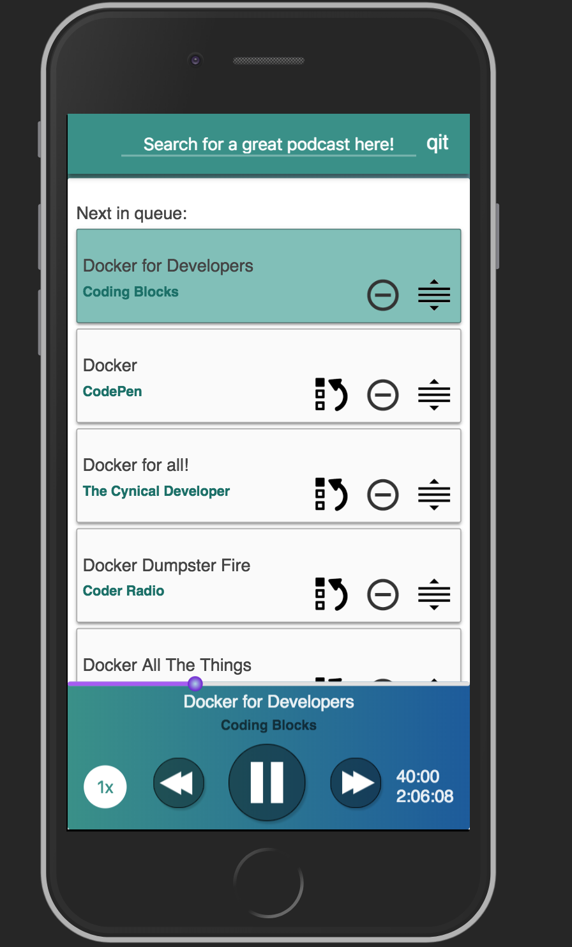
Text Search
Notes:
Indexes about 7,000 episodes
Query it in about 0 seconds, rounded up
Search engine allows us to focus on UX

Slide 10
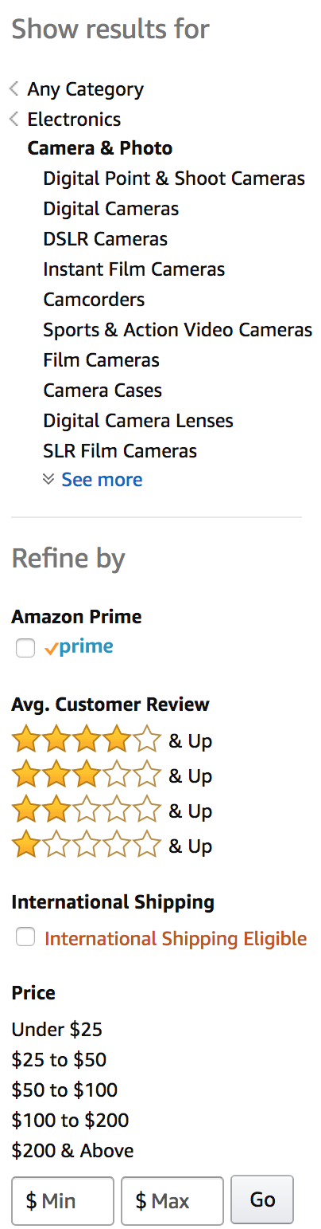
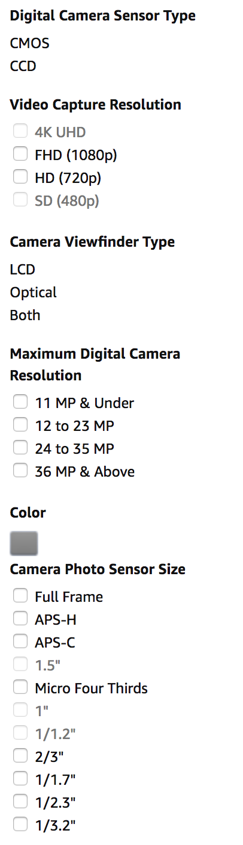
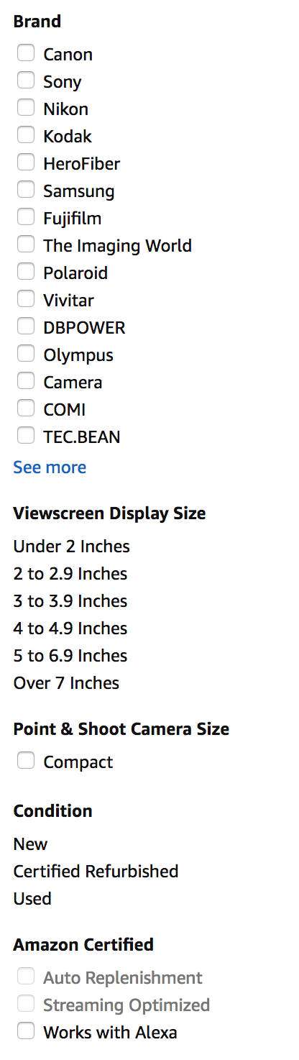

Aggregation and Filtering
Notes:
80,000 for “camera’
In addition to the fuzzy search…
Sliced up the data in interesting ways:
One-to-Many relationships
Numeric Ranges
Custom Data

Slide 11
Notes:
Splunk DataDog
Difference here is
Windows 2012
Python 2.7
How does near real-time jive with the up front processing of indexes?
In practice, it’s not that slow, and most of the stuff we want to see graphed doesn’t need complex processing (synonyms, stop words, phrases)

Slide 12
Building Azure Search Apps
Notes:
Joe Zack, dev, podcaster, pokefan
Building applications Azure Search
Overview of search engines
Code through an App
Tour of advanced features
Ready and able to go build some apps, and drop links in the comments below
https://www.kisspng.com/png-squirtle-pikachu-pokmon-blastoise-charmander-squ-4321888/

Slide 13

Like this talk? Check out the show!
Joe Zack
@codingblocks
Notes:
Like this talk? Check out the show!

